Slide 1
Mastering Technology to Keep Our Customers
“Best In Class”
ADVANCED VEHICLE
TECHNOLOGY

Slide 2
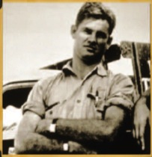

Company Overview | Our History
1933
85 Years
Company
Founded
1930s
Ryder Goes Public
1950s
Fueling
Growth
1970s
Sharpening Our Focus
1990s
Focus on
Growth
TODAY
●        
JIM RYDER MAKES A
$35
DOWN PAYMENT ON
ONE TRUCK
Growth in a Time of Turmoil
1940s
Establishing Our Brand
1960s
New
Horizons
1980s
Driving
Forward
2000s
1930 - 60’s
1970 - 80’s
1990’s
2000’s
2010’s
Grew rapidly by focusing on transportation solutions
Trucking deregulation; diversified into non-core businesses
Divested non-core businesses
Improved performance through process changes
Focus on Growth
1
Notes:
Talking Points for Speaker:
Jim Ryder started this company with a $35 down payment on one truck.
Today, we have more than $6 Billion in annual revenue
And that one truck has become a huge fleet: Ryder now has the largest fleet of commercial vehicles in North America with more than 200,000 vehicles on the road.
And our footprint has extended well beyond trucks – we have 29,000 employees and operate nearly 35 million square feet of warehouse space and over 800 service and maintenance locations across North America

Slide 3








Company Overview | Operations
TODAY
Providing outsourced transportation and logistics solutions for commercial customers
FLEET LEASING & MAINTENANCE SOLUTIONS (FMS)
RYDER IS A FORTUNE 500 COMPANY WITH:
$7.3 billion
ANNUAL REVENUE
240,600
DEDICATED TRANSPORTATION
SOLUTIONS (DTS)
VEHICLES
36,100
EMPLOYEES
50 million
SQUARE FEET OF WAREHOUSE SPACE
SUPPLY CHAIN SOLUTIONS (SCS)
800+
SERVICE &
MAINTENANCE
LOCATIONS

Slide 4



Company Overview | Capabilities & Solutions
Fleet
Management Solutions
Flexible Lease Options
Fleet Financing
Contract Maintenance
Commercial Rental
Used Vehicle Sales
Fleet Support Services
  Fuel
  Insurance
  Safety Services
  Regulatory Reporting (DOT)
  Customer Web Portal (CWP)
  Fleet Parts & Products
Transportation Management Solutions
Procurement and carrier management
Shipment optimization and load planning
Routing
Freight brokerage
Network Optimization
Financial Settlement and administration
Operational Execution
Cross-border solutions
Distribution Management Solutions
Warehouse/distribution center operations
Packaging & postponement
Order fulfillment
Inbound materials management
Outbound product support
Reverse logistics
Vendor managed inventory
Facility Design Services
Supply
Chain
Solutions
Network Modeling
& Optimization
Warehouse Management & Cross Docking
Dedicated Contract Carriage
Carrier Procurement
Capacity Management
Shipment Planning & Execution
Transportation Network Consulting
Fleet
Support & Technology
Customer Web Portal (CWP)
RyderGyde App
RyderSafetyServices.com
RyderFleetProducts.com
Online Invoice
Online Rental
Usedtrucks.Ryder.com
RyderShare
COOP by Ryder
RyderTrac.com
RyderShip.com
RyderFlow.com

Slide 5


Guided by our Vision, Mission and Values
VISION
To bring compelling value through outsourcing
MISSION
Ryder provides
innovative supply chain and fleet solutions that
are reliable, safe and
efficient, enabling our customers to deliver
on their promises
VALUES
Trust
Innovation
Collaboration
Expertise
Safety

Slide 6





SERVICES | Fleet Management Services (FMS)
Fleet Management Solutions
ChoiceLease
SelectCare
Commercial Rental
Used Vehicle Sales
Fleet Support Services
Flexible Leasing options:
  Full Service
  Preventive
  On-Demand
Wide variety of truck sizes and specifications to meet your unique fleet requirements
Leverage Ryder’s scale and buying power with major OEMs
Flexible managed maintenance options:
  Full Service
  Preventive
  On-Demand
Vehicles are owned by our clients or under third-party finance lease contracts
Commercial vehicles for short-term customer needs
Access to 37,800 new and late-model commercial vehicles in North America
Largest retailer with 59 Used Truck Centers throughout North America and Canada
Flexible financing
Full maintenance history and only one prior owner (Ryder)
Rigorous 140-point inspection
Guaranteed reliability
Fuel
Insurance
Safety
Regulatory reporting
Technology
Fleet Parts & Products
Sample Clients (Maximizing Uptime):

Slide 7

About Ryder | Environmental Sustainability
Saving more than just the environment
Ryder is a leader in providing environmental, cost-saving, and service benefits for more efficient transportation and logistics operations. From alternative fuels to carbon reporting to green supply chain engineering programs, Ryder has what you need to be lean and green.
Advanced Fuels
More than miles of natural gas experience
$100 million invested in advanced fuels
5,900+ trained technicians
Exclusive maintenance and distribution provider for Nikola
Sustainable Warehousing
Best practices in energy conservation:
  Facility design
  Lighting
  Atmospheric controls
Evaluate energy performance with Ryder’s environmental due diligence process
We are measuring and reporting our electricity, natural gas, water, and sewer use for all U.S. and Canada operations
Waste Management
We recycle and re-use:
  Automotive/vehicle waste items associated with maintaining a fleet
  Products made from recycled materials, including retread tires and re-refined motor oils
  2M+ gallons of vehicle washing waste water annually
  We recycle all retired electronic components, computers, and component parts at all of our locations in the U.S. and Canada
Diesel Fuel & Exhaust Fluid
We deliver only low-emission, ultra-low-sulfur diesel (ULSD) fuel in all our fueling stations

Slide 8
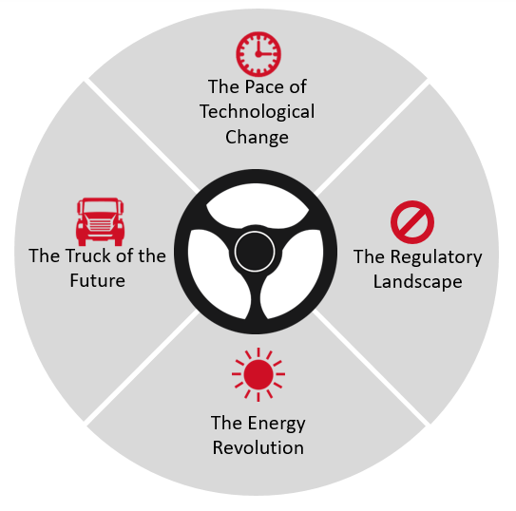
“ A Technology Company”
The Ryder Advantage: Delivering meaningful solutions in this fast-changing environment
Access and Risk Mitigation
Committed to Electric Trucks
Exclusive OEM Relationships

Slide 9
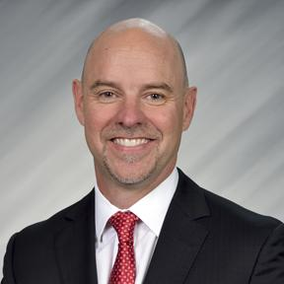


Embracing Disruption and Leading Change
“There are a lot of changes on the horizon within our industry in terms of electric and autonomous vehicles, asset and freight sharing (the Uber effect) and within e-Commerce and the speed with which customers expect delivery (the Amazon effect).”
Robert Sanchez, Chairman and CEO, Ryder System, Inc.

Slide 10
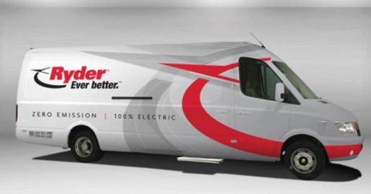


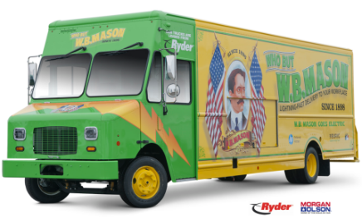
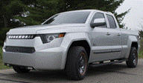
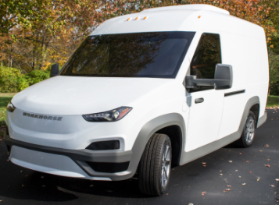
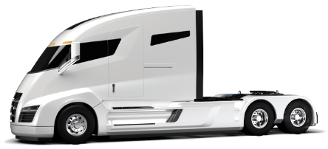
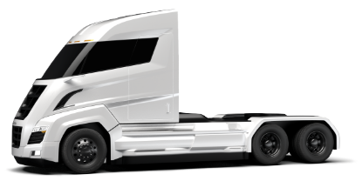

Exclusive Non-Traditional Electric Truck OEM Partners
Available NOW!
Available 2019
Available Q4 2018
Available NOW!
Available in 2020

Slide 11


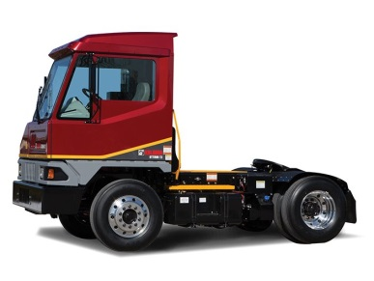
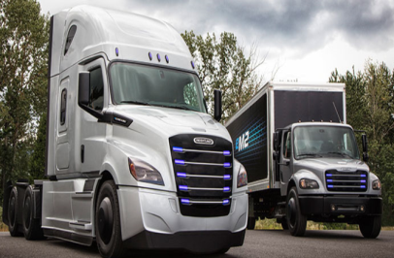
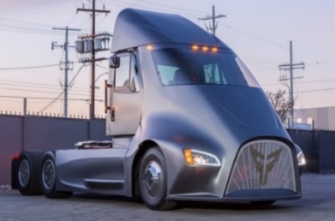



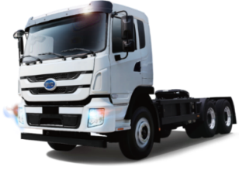
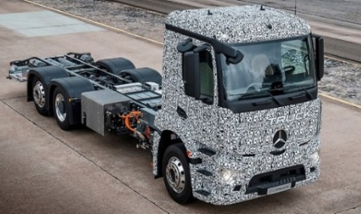
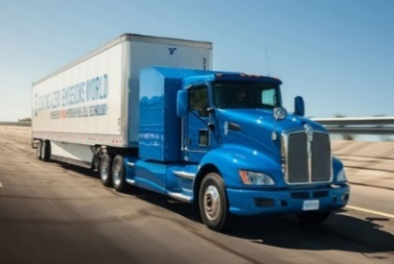


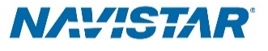
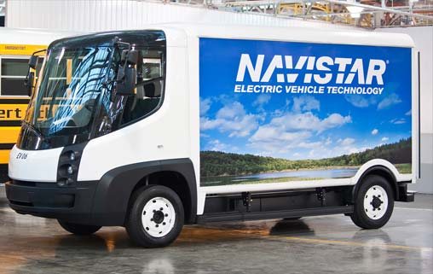
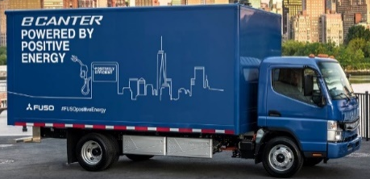
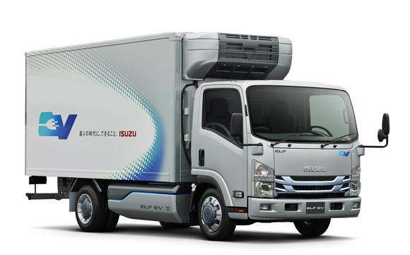
Other Electric Truck OEMs
THOR

Slide 12
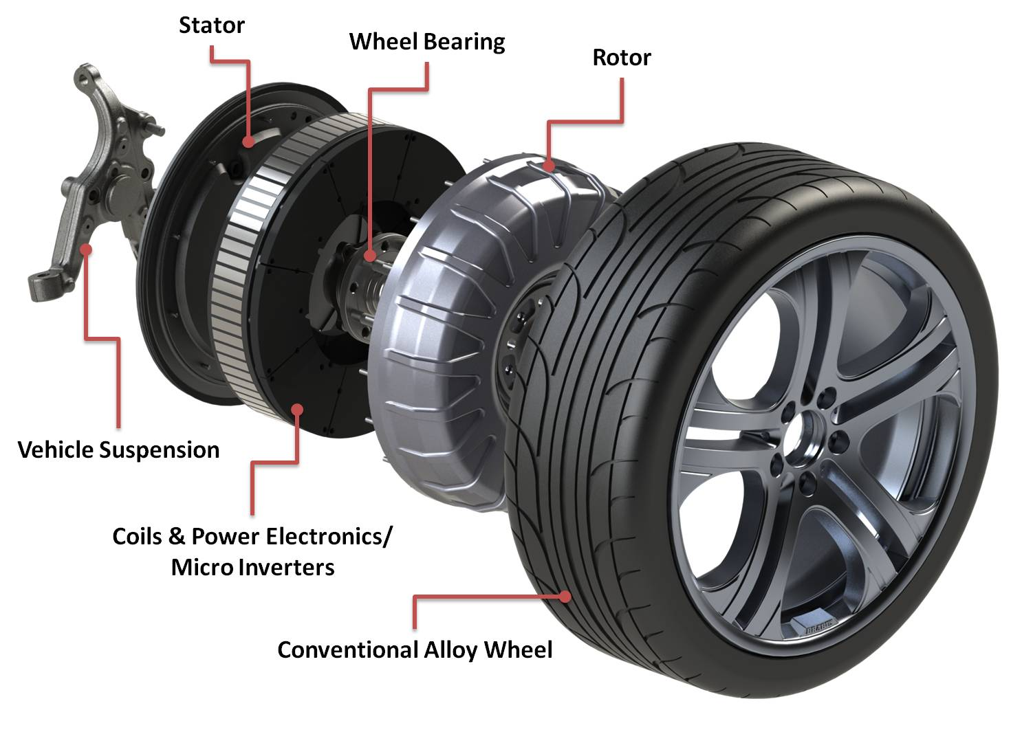
Electric Motor Advantages
Electric Motor has 4 to 6 moving parts
  Zero Emissions and Reduced Emissions
  Great Power/Performance
  Battery Technology Advancements
  No Transmission
  Lower Maintenance Costs
  Lower Energy Costs
  Financial Incentives for Early Adopters
  Range Extenders – No “Range Anxiety”
ICE (Internal Combustion Engine) has over 1,000 moving parts

Slide 13
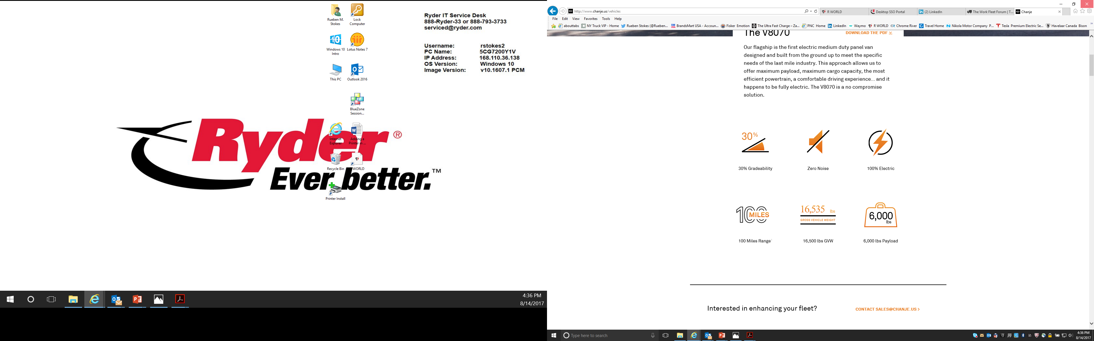
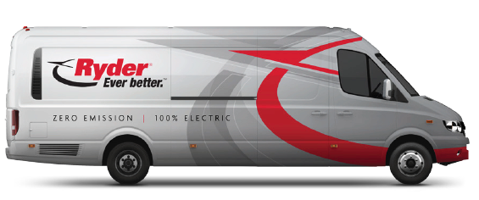

Next Level Capabilities
*
*
2018 Models will be available with 140 Mile Range
Same Carbon Emissions Footprint

Slide 14
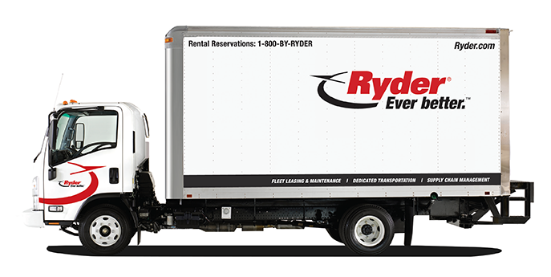
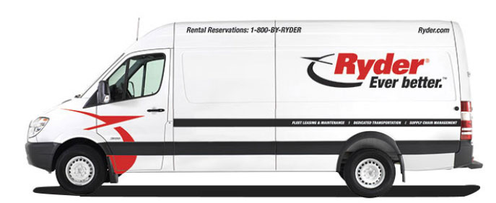
Urban Distribution Sweet Spot
26 Ft.
19 – 24 Ft.
18 – 24 Ft.

Slide 15
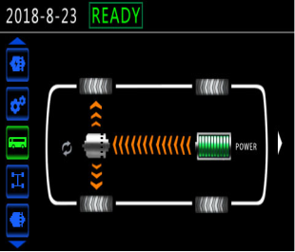
V8100 Advanced Technology
Touch Screen UI & Connectivity
Features a 10.4", Android-based touchscreen display with LTE connectivity to control most of the van’s features.

Slide 16
V8100 — Specifications
Dimensions
Wheelbase (in/mm)
194.3 / 4,935
Overall Length (in/mm)
318.1 / 8,080
Overall Width Excluding Mirrors (in/mm)
86.4 / 2,195
Overall Height (no roof rails) (in/mm)
107.7 / 2,735
Curb Weight (lb/kg)
10,535 / 4,778
Gross Vehicle Weight (lb/kg)
16,535 / 7,500
Total Payload (lb/kg)
Up to 6,000 / ~2,870
Cargo volume (cu ft)
675
Mechanical
Drive Configuration
RWD
Motor Type
Synchronous Permanent Magnet
Number of Motors
Dual Motor System
Motor Cooling Method
Liquid Cooling
Battery Capacity
100 kWh
Battery Chemistry
LiFePO4
On-Board Charger
14.4 kW
Charge Port
SAE J1772 Level 2 + DC Fast
Performance
Total Peak Power (hp/kW)
198 / 148
Total Peak Torque (lb-ft/Nm)
564 / 764
Top Speed (mph/kmh)
80 / 130
Max. Gradeability [%]
30%
Turning radius (ft)
26.6
Range (mi)
150
MPGe
50
Chassis
Body Construction
Unibody
Front Suspension
Independent
Rear Suspension
Leaf Spring
Tire Size
215/75R17.5
All information contained in this specification sheet are based on the latest data available at the time of publication. Final specifications and numbers are subject to change at final production.
Chanje Energy, Inc — V8100

Slide 17
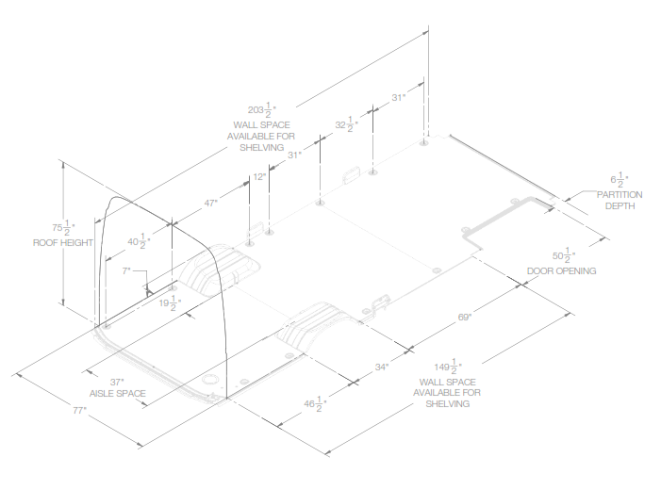
V8100 – Internal Dimensions

Slide 18
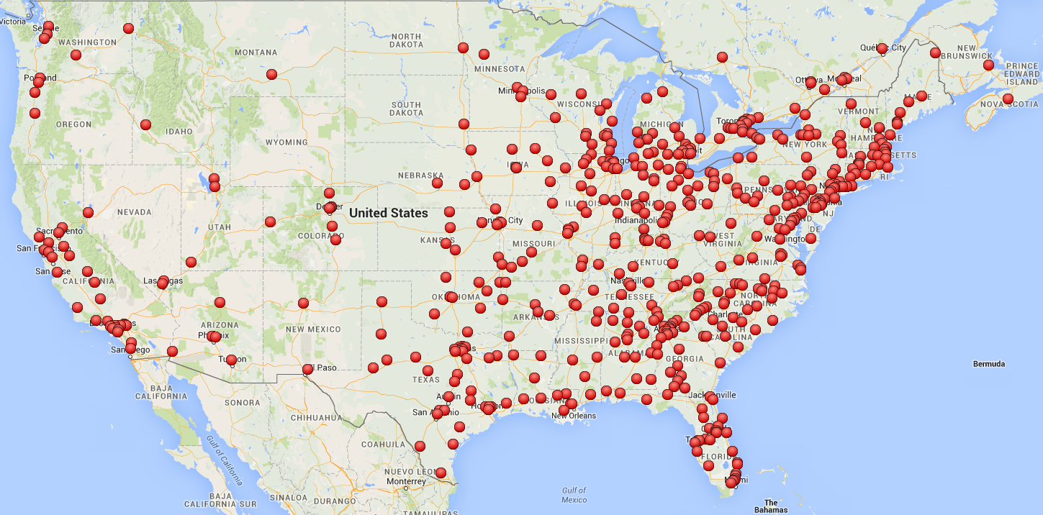


Launch Markets
New York
NYC (x3)
Sacramento
San Francisco
Chicago (x2)
Hayward
San Jose
Illinois
California
Current Ryder EV Retrofitted Shops
*Expansion plans across CA in 2019 &
additional metro markets nationwide as CEV
funding becomes available
ALL Ryder Shops
Los Angeles (x4)
San Diego

Slide 19
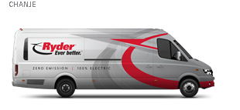




Pricing Summary – 100% Electric Vehicle
Special Rate for the First50 Leases!
Ryder 100% Electric Chanje V8100 Vehicle
ChoiceLease Preventive
Monthly Fixed Rate Options:
3-yr term: $999.00/month
7-yr term: $899.00/month
*No Variable Rate
Pricing includes 1 EV Mobile Charger by eMotorWerks
(installation not included)
4 Preventive Maintenance Services Annually
Proprietary and Confidential |

Slide 20
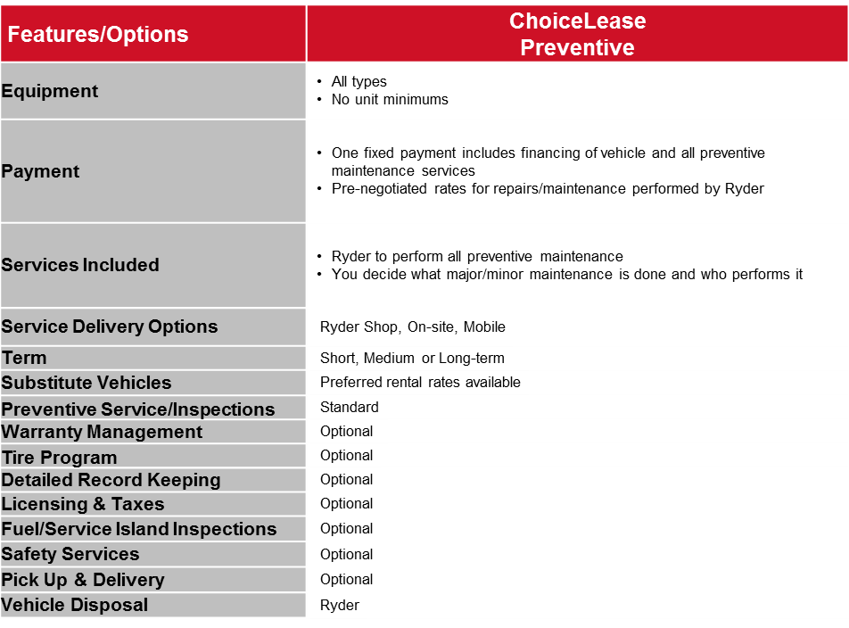
ChoiceLease Preventive | Overview
Maximize vehicle up-time with Ryder’s 800+ shop locations, maintenance expertise and proven reliability.
Key Features
Equipment & Fleet Administration
  Leverage Ryder’s scale and buying power with major OEMs
  Vehicle administration (Licensing)
5,900 trained, certified service technicians with deep knowledge of:
  Latest EPA certified engines and other fleet technology
  400+ certified refrigeration technicians
  Multi-OEM diagnostics for all major brands
Repairs performed at:
  Ryder’s 800 shop network
  Onsite at your location via mobile truck
Extensive inventory of fleet-specific parts
Emergency roadside assistance, warranty and tire management
Rental fleet access to 37,800 vehicles while your truck is being repaired
Feature Set

Slide 21

About Ryder | Awards & Recognition
Top 3PL
    Food Logistics (2008-2017); Inbound Logistics (2008-2017);
    North American Automotive Global Awards (2016)
Green Supply Chain Partner
Inbound Logistics (2009-2015)
Gold Award for Best Measurement in Customer Service
Loyalty360 (2016)
Top Green Provider
Food Logistics (2012-2017)
Great Supply Chain Partner
SupplyChainBrain (2003-2016)
  Quest for Quality Award (Reader’s Choice)
  Logistics Management (2004, 2006-2007, 2009-2011, 2014)
Most Valuable Employer for Military
  CivilianJobs.com (2013-2016)
    America’s Best Employers
      Forbes Magazine (2015-2017)
      World’s Most Admired Companies
      Fortune Magazine (2009-2010, 2013-2017)

Slide 22

Ryder Advanced Vehicle Technologies - Contact
Julie Johnson
Manager, National Business Development
Advanced Vehicle Technologies
Julie_C_Johnson@ryder.com
415-577-2983 (Mobile)

