Slide 1
CYBERSECURITY FOR AUTONOMOUS VEHICLES
LAURA MARTINEZ
CYBERSECURITY STRATEGY DIRECTOR, INTEL

Slide 2
Agenda
Cybersecurity Threats & Autonomous Driving (AD)
What are the levels of AD?
Changing laws; where are they headed?
What are the benefits and concerns around AV’s?
What are the security concerns for an organization?
How can you protect your organization from these threats

Slide 3
Summary
Automotive cybersecurity must evolve as automation technologies replace driver actions.
There is a need to develop advanced cybersecurity solutions for these new workloads and additional exposed surfaces.
Utilizing artificial intelligence technologies such as cognitive machine learning subsystems, sensors, object processing, vehicle to infrastructure and in-vehicle critical subsystems with hardware rooted security are some of the approaches we will discuss.
We must also expedite the coordination among technology companies, autonomous vehicle providers, and end-users.
Notes:
Speakers notes:
I am pleased to join the Sacramento Clean Cities Event. My name is Laura Martinez, and I am the director of cybersecurity strategy at Intel. This is even more exciting in light of the recent news released on Tuesday, “GM will be the first company to test self-driving cars in New York City”. I don’t know about your fleets, but I can tell you that most fleets have some bumpers missing due to distracted driving, and could really use some automation introduced into the driving patterns!
Quick story: I was listening to a story that a family member was telling, and he said he just got a new car- and it saved his life! Wow, I thought, what a great lead in for my talk with you all. He mentioned he was driving and got distracted, and alas, looked at his phone (that just wouldn’t stop beeping!) and slammed him forward. His car had avoided an accident by hitting the brakes for him! If he hadn’t purchased the AD package, he would have crashed his 1 day old car!
So what is Autonomous Driving? AD or Autonomous Vehicles’s have levels of autonomy, but basically are vehicles that can drive without human conduction.
But… How does the industry define it? Well, let’s take a look.
Slide 3: Levels of Automation
Many of you may be familiar with SAE, which is a globally active professional association that develops standards for engineering professionals in various industries, but their principal emphasis is placed on transport industries such as automotive, aerospace, and commercial vehicles. SAE has provided the following levels of automation: 0 -5.
No automation
Either steering or acceleration/deceleration – think speed control
Both steering and acceleration/deceleration – think of my happy relative here ☺
Platooning -All aspects of dynamic driving for following trucks, BUT NOTE, the lead truck requires constant human interaction (lobbyists do not like this)
& 4 All aspects of dynamic driving, but 3 requires constant human monitoring & intervention and level 4 requires conditional human monitoring
5- Fully automated –
Let’s look at the legalities around AD.
Slide 4: What are the legal implications?
There are a lot of lobbying dollars hard at work to stop the autonomous driving catalyst.
$61MM from the automotive industries and another $8.5MM from the trucking industries.
Congress is reviewing more legislation around AD in the trucking industry, and lobbyists won a small victory for the unions, but will not stop the movement from happening. Just like pilots using “auto-pilot”, the automomous fleet will follow. And your cities, counties and the state may be leading the way.
I wanted to highlight something that many bring up and that is safety… in a direct quote from Ken Hall, general secretary-treasurer of the International Brotherhood of Teamsters: “I have yet to hear a serious discussion about how we will make sure an 80,0000-pound automated truck will be able to maneuver around a warehouse or drop yard and not injure the countless workers also occupying that same space”… we know there are risks but do they outweigh the costs?
Slide 5: Benefits outweigh the costs. But there are safety and privacy concerns – these privacy concerns are more prevalent in the fleet world, than that of the private daily driver.
We need to address user privacy. We are looking at solutions that protect and anonymize users’ identity using pseudonyms and identification as part of a legitimate group versus unique identities.
For example, in a recent scenario in a major European city, without privacy controls in place, the movements of the city’s Mayor could be tracked via the city’s smart parking infrastructure.
Slide 6: Why does the industry want to make self-driving vehicles and connect them?
Well, the simple answer is to save lives. There are too many accidents caused by inattentive drivers (AKA distracted drivers). Automation, where vehicles will brake if the driver does not react on time, is one of primary motivators to this self-driving future.
But these vehicles have tons of data they are sharing – how do we secure the data?
Slide 7: Let me start with the vehicle security. Autonomous vehicles are akin to virtual “Data Centers on wheels”.
This vehicle, that you see here, could comprise of:
Up to 100 Electronic Control Units (ECUs)
Up to 200 microprocessors
And it may have 9 types of networks based on a variety of protocols.
On top of that, there are up to 100 million lines of code in a modern vehicle, growing to 300 million as we move towards autonomy.
Slide 8: To secure this new mode of transportation, a strong hardware foundation is required and Intel will provide the necessary building blocks to secure the data in motion (pun not intended). Allow me to frame and simplify Intel’s focus in cyber security for autonomous and connected driving. Intel’s focus is in 3 areas:
1. Protecting the vehicle with a hardware foundation that includes trusted execution environments and the integrity of communications… and this at low latency.
2. Securing the connectivity from the vehicle to the infrastructure or other vehicles, so that we know that the data comes from a trusted source, and was not tampered with.
And finally, the protection of the privacy of the occupants and the operators of the vehicle.
Slide 9: Additionally, Intel is working with leaders across the fleet industries to enhance the security of vehicles by building a chain of trust from a hardware level all the way to the operational level of the vehicle. We are doing so:
By implementing attestation (a form of certification/encryption) so we can verify the integrity of the subsystems and the system-of-systems – not only in the car, but when they are reporting into the infrastructure.
And by enabling the ability to isolate critical code so it can be executed in a protected environment.
We have to establish a basis of trust.
Through close collaborations, we can add software isolation and partitioning, additional services such as whitelists, control-flow execution enforcement, and key and certificate management.
Slide 10:
We are researching and driving self-adaptive mechanisms that enable the car:
To evaluate and modify its behavior to improve efficiency.
… and to protect itself so that it can identify anomalies while running and self-correcting.
Such adaptive and auto-remediation techniques will be necessary for the autonomous vehicles that heavily rely upon artificial intelligence solutions.
With these technologies, it will be possible to identify anomalous behaviors by using biometrics, and machine learning to analyze and compare patterns of the good known human users with unusual patterns.
The autonomous vehicles will need secure and low-latency wireless connectivity to be broadly adopted… and to achieve that, Intel is working with our partners to deploy:
Strong encryption
Secure connectivity
and End-to-End Trusted Execution Environments
Attestation to the integrity of outbound or generated data is also important for uses such as for insurance purposes where the telemetry data must reach only an authorized entity analyzing it for an insurance claim.
Trusted execution environments are also critical to protecting key algorithms and models with key code running only in secure enclaves.
Neural network algorithms are becoming more popular to process vision, speech recognition and image classification … with better performance than humans. However, they can be exploited.
To fully utilize the deep learning algorithms in this space, Intel is working w/international universities, such as Tel Aviv University, Georgia Tech and Princeton University to research the analytical vulnerabilities of these AI deep learning algorithms to develop resilient defense mechanisms.
Last but not the least, Intel wants to help address user privacy. Intel is looking at solutions that protect and anonymize users’ identity using pseudonyms and identification as part of a legitimate group versus unique identities.
Last slide: In conclusion, Intel will be at the forefront to implements concealment preserving technologies, so that the data produced by the earlier example of the Mayor’s car can still be analyzed without compromising his privacy. Or, in the instance of your fleet, we can look at the data going between the vehicles and the infrastructure that is managing this information (likely via dashboards built through the telematics systems you employ), and ensure it is secure and cannot be viewed by those outside of the circle of trust.
We look forward to the road ahead, the continuous innovation in this space and our future collaborations to increase the security of the autonomous vehicles.

Slide 4
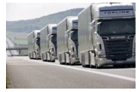
Levels of Automation
SAE: Level 5
SAE: Level 4
SAE: Level 3
SAE: Level (2.5)
SAE: Level 2
Full Automation: All aspects of dynamic driving, requires no human monitoring & intervention Driver Involvement: None
SAE: Level 1
High Automation: All aspects of dynamic driving, requires conditional human monitoring & intervention Driver Involvement:
Low
SAE: Level 0
Conditional Automation:
All aspects of dynamic driving, requires constant human monitoring & intervention Driver Involvement: Moderate-low
Platooning:
All aspects of dynamic driving for following trucks, lead truck requires constant human interaction Driver Involvement: Moderate
Performance
Partial Automation:
Both steering and acceleration/decel eration
Driver Involvement: High
Driver Assistance: Either steering or acceleration/decel eration
Driver Involvement: High
No Automation
Driver Involvement: Very high
Safety/Control

Slide 5
Legal Environment Complex for Commercial…
Both segments have to deal with legislation issues, but commercial vehicle have the added headwind of being out spent by opposing industries on lobbyists (even if Congress passes laws for AV’s, drivers will still be necessary)
AV Legislation Map Lobbying Dollars Spent By Industry
$61,677,268
$26,024,181
$8,558,388
$12,565,342
Automotive Trucking Railroad Trans. Union
“For the past 15 years, there has been a proposal from the American Trucking Association to raise the 80,000lb limit in trucks to 97,000lbs. Railroad lobby has killed this every year for 15 years.”
-Former COO Tier 1 Supplier
Headwind
Headwind
Tailwind
Tailwind
Notes:
Source:: Autonomous Commercial Fleet IDIs of BDMs from OEM, Tier1, Fleet Operators, Regulators, (n=40) Jan. 2017, Frost & Sullivan internal research studies & analysis 2016
Opensource.org report from Senate Office of Public Records Jan2017
http://www.detroitnews.com/story/business/autos/mobility/2017/09/13/senators-weight-impact-self-driving-trucks/105579172/

Slide 6
Commercial Key Benefit, Lower Privacy Concerns…
Both segments have similar benefits with the exception of commercial having a perceived lower level of security and privacy issues.
Less security & privacy issues than passenger vehicles (who has access to data?)
Operational efficiencies
Decrease accidents/reduce automotive fatalities
Decreased traffic/parking congestion
Decrease accidents/reduce automotive fatalities
Decrease traffic/parking congestion
Increase mobility of those unable to drive
Decrease fuel consumption
Notes:
http://www.detroitnews.com/story/business/autos/mobility/2017/09/13/senators-weight-impact-self-driving-trucks/105579172/
“The public discussion in Congress on autonomous vehicles has tended to focus on the impact of small personal cars on our daily lives — increasing mobility for the disabled, and alleviating congestion in our cities,” said Ken Hall, general secretary-treasurer of the International Brotherhood of Teamsters. “I have yet to hear a serious discussion about how we will make sure an 80,0000-pound automated truck will be able to maneuver around a warehouse or drop yard and not injure the countless workers also occupying that same space

Slide 7
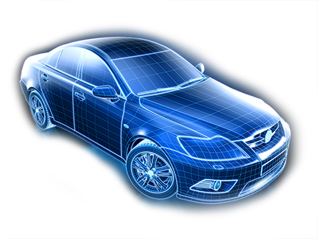
V2X Connectivity
Trusted
Network
(e.g. Repair Shop
Local
Service
V2V
AP
GPS
Local repair shop network
AP
Local Service
Road Side Unit (RSU)
Open AP
Local
Service
Roadside Assistance
Electric
Chargers
Internet
Backbone
Access Point (AP)
Uni-directional Communication
External systems and networks support new services and interactions… and increase risk.
Bi-directional Communication
Radio Data Systems (RDS)
Mobile Devices

Slide 8
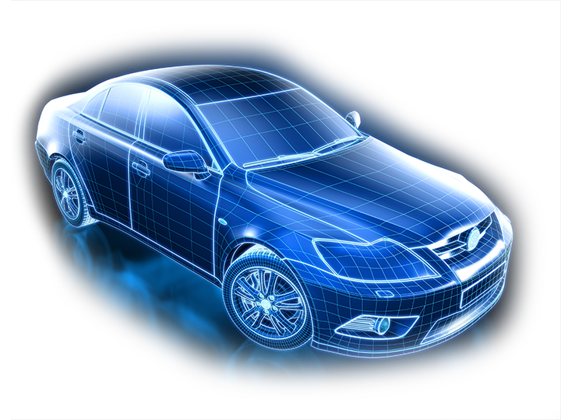
Vehicle Security
Airbag ECU
OBD II
5G Based Receiver
USB
Passive Keyless Entry
Bluetooth
Remote Link Type App
Remote Key
TPMS
Vehicle Access System ECU
ADAS System ECU
Steering & Breaking ECU
Smartphone
Engine & Transmission ECU
Lighting System ECU
(Interior & Exterior)

Slide 9
Sub-system Level Defense-in depth
Comprehensive Security Approach
GPS
Internet backbone
Over-the-air updates
IDPS/anomaly detection
Network enforcement
Certificate management services
Anti-malware and remote monitoring
Biometrics
Fast cryptographic performance
Device identification
Isolated execution
(Message) authentication
V2X antenna
SOFTWARE
Trust and Context
Occupant safety
Surround sensors
Brake control system
Trusted Execution Environment
Electric power steering
HARDWARE
CAN bus
Hardware and Software Identities
Protected Boot
Protected Storage
Electric Chargers
Mobile Devices

Slide 10
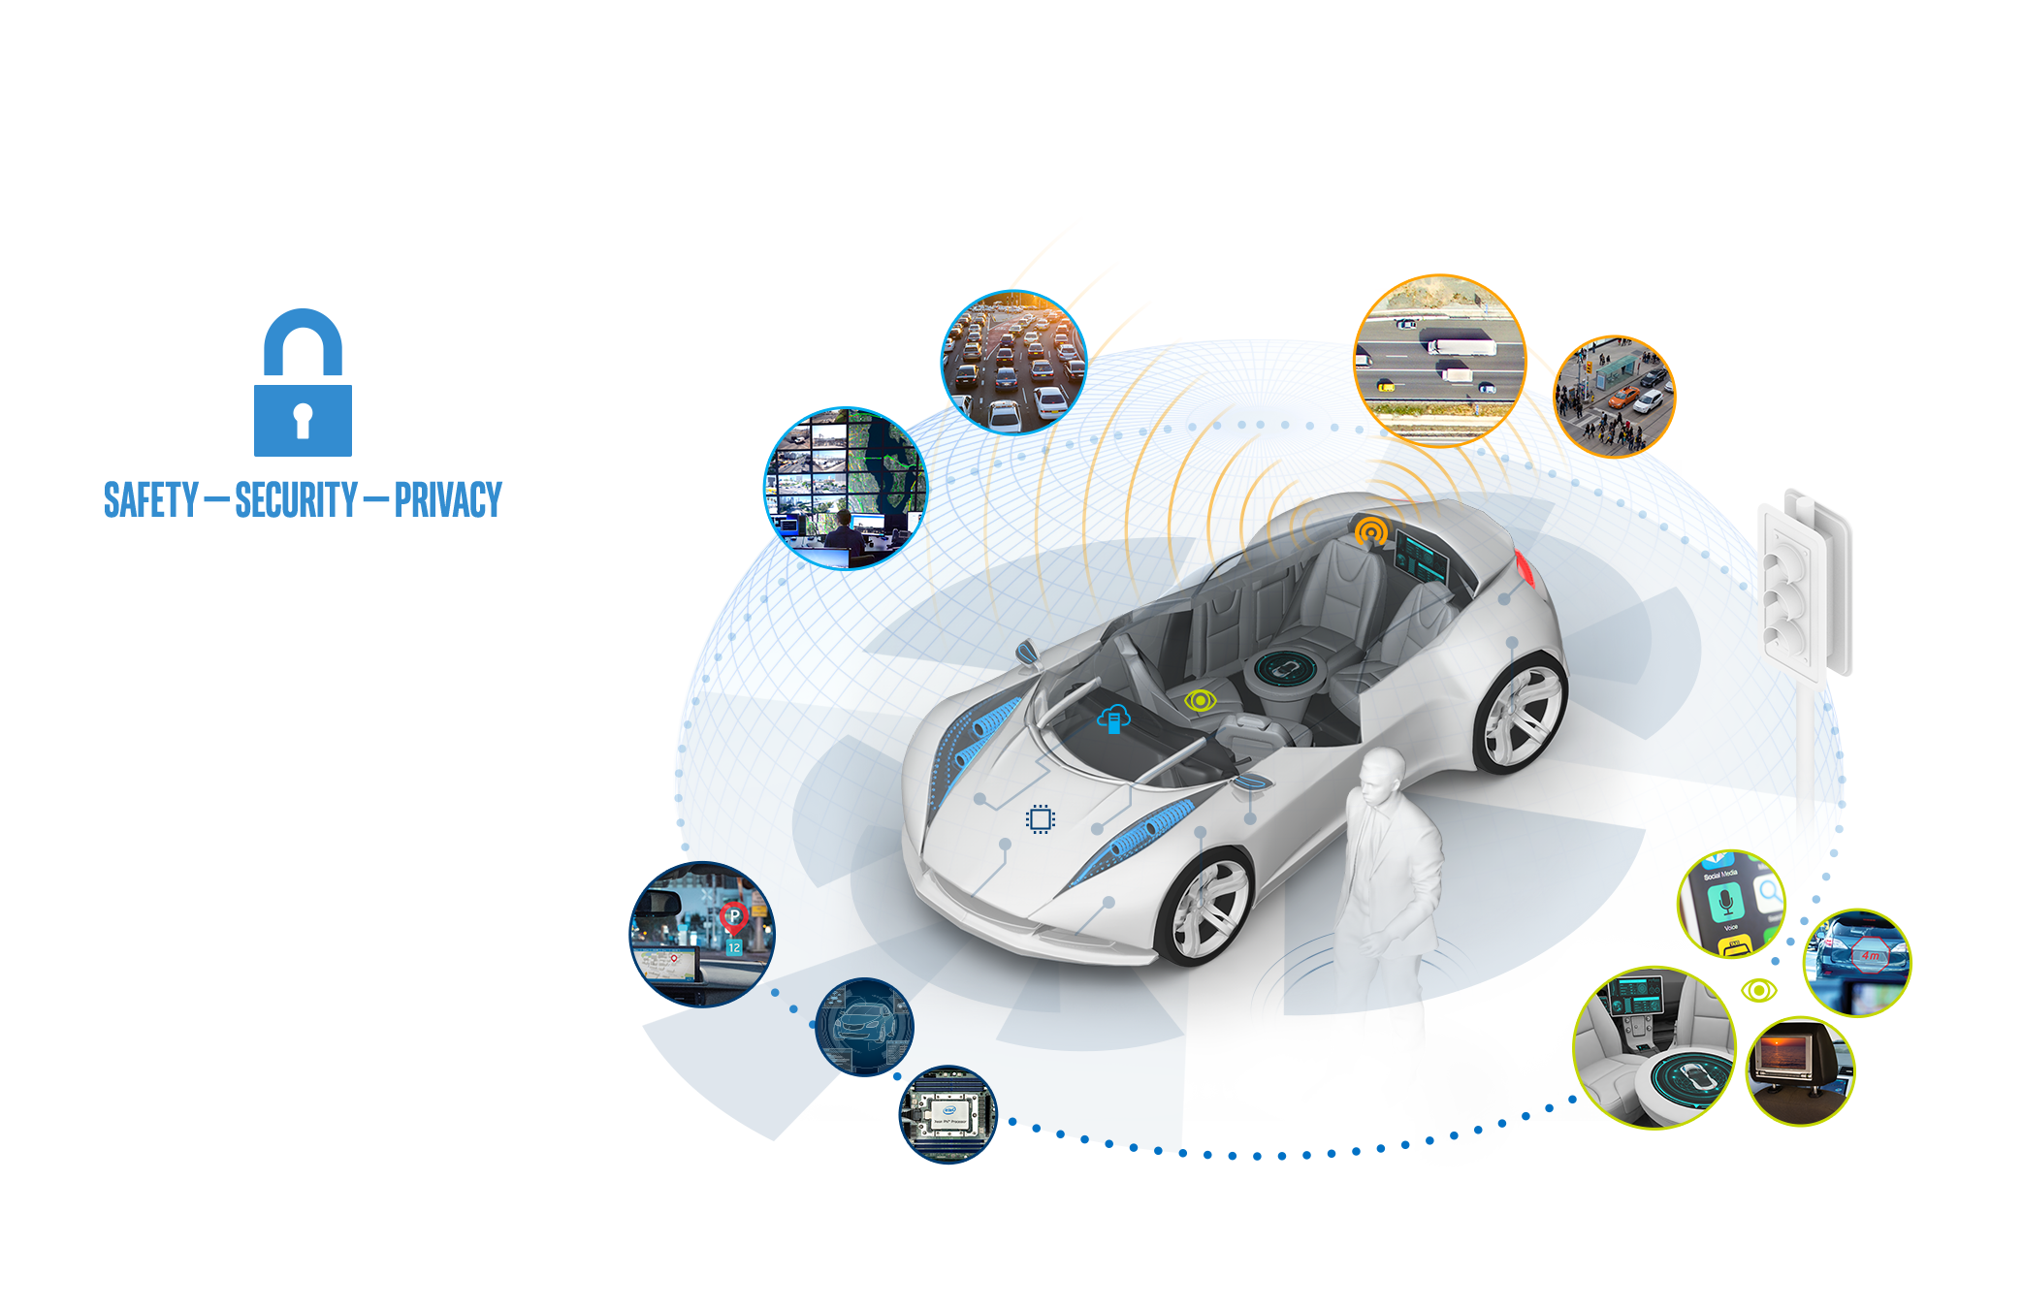
Data, Algorithms and Privacy

Slide 11
INDUSTRY COOPERATION

Slide 13
The formalized model for fault allows for the creation of decision-making (driving policy) software that avoids accidents caused by the AV system. It also enables validation in an efficient manner.
AVs have 360-degree vision and lightning-fast reaction times, can analyze road conditions and available braking power, and are never distracted. Given this, plus the formalized model to determine fault, AV developers can design a system where the software can evaluate every command against this model.
Mobileye has designed such a system, and it is called Responsibility-Sensitive Safety (RSS). RSS ensures that, from a planning and decision-making perspective, the AV system would not issue a command that would lead to the AV causing an accident.
This system avoids the data-intensive validation process that most AV developers seem to be planning, which we see as not feasible (whether performed on-road or in a simulated environment). It is simply validated by proving that the system evaluates all commands against the predetermined set of mathematical rules.
Notes:
How safe is safe enough? Our system can validate three orders of magnitude improvement to one traffic fatality for every one billion hours of driving versus the human-driven vehicle rate of one traffic fatality for every one million hours of driving (i.e., a US traffic fatality rate of ~40 per year compared to ~40,000 in 2016).
We don’t believe society will accept machines causing accidents unless a drastically reduced fatality rate can be proven.
While the RSS decision-making software is designed to not allow decisions that would result in an accident that would be blamed on the AV driving policy, there could still be accidents caused by mistakes of the sensor system (i.e., the information about the driving environment that is used to base decisions) or mechanical failure.
We propose a Sensor Fusion system that includes three independently engineered systems, each relying on different technologies: 1) camera, 2) high-definition map, and 3) radar and lidar.
The system can be validated to a miniscule error rate (supporting the rate mentioned in a heading) with a very reasonable data set of real-world miles driven—specifically 100,000 hours.
Details of our approach to safety
At its core, RSS is a pragmatic method to design and then to efficiently validate the safety of an AV’s planning/decision-making (driving policy) software.
As absolute safety is impossible as long as AVs share the road with human drivers, we start by defining an AV as safe if it doesn’t cause collisions.
In order to prove that the AV won’t cause collisions, we must first construct a mathematical model that determines blame when collisions occur, using a comprehensive set of driving scenarios. Essentially, we formalize the “common sense of fault” using mathematical equations. We can set these equations with certainty as the AV will have known reaction times and known ability to make evasive maneuvers through steering and braking.
The powerful result of formalizing this model of blame is that it enables us to construct the decision-making software of the vehicle to follow these exact parameters, continuously evaluate these rules, and never make a command that would put the vehicle at risk of causing a collision.
In practice, the AV needs to know two things:
Safe State: This is a state where there is no risk that the AV will cause an accident, even if other vehicles take unpredictable or reckless actions.
Default Emergency Policy: This is a concept that defines the most aggressive evasive action that an AV can take to maintain or return to a Safe State.
We coin the term Cautious Command to represent the complete set of commands that maintains a Safe State. RSS sets a hard rule that the AV will never make a command outside of the set of Cautious Commands. This ensures that the planning module itself will never cause an accident.
Following scenario
To illustrate, let’s take a common example. Consider the case of two cars driving in the same lane, one behind the other, along a straight road. If the front car brakes and the rear car cannot brake in time, the accident is the fault of the rear car. As seen in the figure below, we can calculate the exact distance corridor that the following car (blue) must leave to the lead car (red) to be in a Safe State. This calculation depends on data for certain variables, such as the difference in velocity between the two cars, which will be provided with high accuracy by the various sensors in the AV.
Figure 2. The above formula calculates the safe longitudinal distance between the rear vehicle and the front vehicle.
Cut-in maneuvers
The above is a fairly simple scenario. It captures the intuitive principle that if a rear car hits a front car, it’s always the rear car’s fault. But what happens if the front car performs a reckless cut into another car’s trajectory and the rear car then hits the front car from behind? In that case, it’s the front car’s fault.
RSS is well-equipped to deal with this scenario using the same principles. Based on a set of variables, a safe corridor exists around the AV. If the human-driven vehicle (red car in figure below) violates that corridor before the collision occurs, it is that vehicle’s fault. Conversely, the AV can continuously calculate the safe corridor around other vehicles and will never make a command that violates that space.

Slide 14
4 Predominant autonomous fleet use cases …
10
9
8
7
6
5
4
3
2
1
Applicability
Urban | Refuse | Transit | Taxi | Port/ | Shuttle | Factories/ Cons- | Regional | Coach | Long-haul
Parcel |  | bus |  | Harbor |  | Warehousing truction | -haul
13
Notes:
Source: Autonomous Commercial Fleet IDIs of BDMs from OEM, Tier1, Fleet Operators, Regulators, (n=40) Jan. 2017, Frost & Sullivan internal research studies & analysis 2016
Note: Long-haul and Coach Bus: > 250 miles per day;
Regional-haul and Construction: <250 miles per day. Values for use cases derived through Cognisights interviews

Slide 15
Reading prep materials
AI and cybersecurity: a match made in heaven
Analytics, AI and Orchestration and Top New Security Topics
Cyber threats are growing more serious, and artificial intelligence could be the key to security

