Slide 1
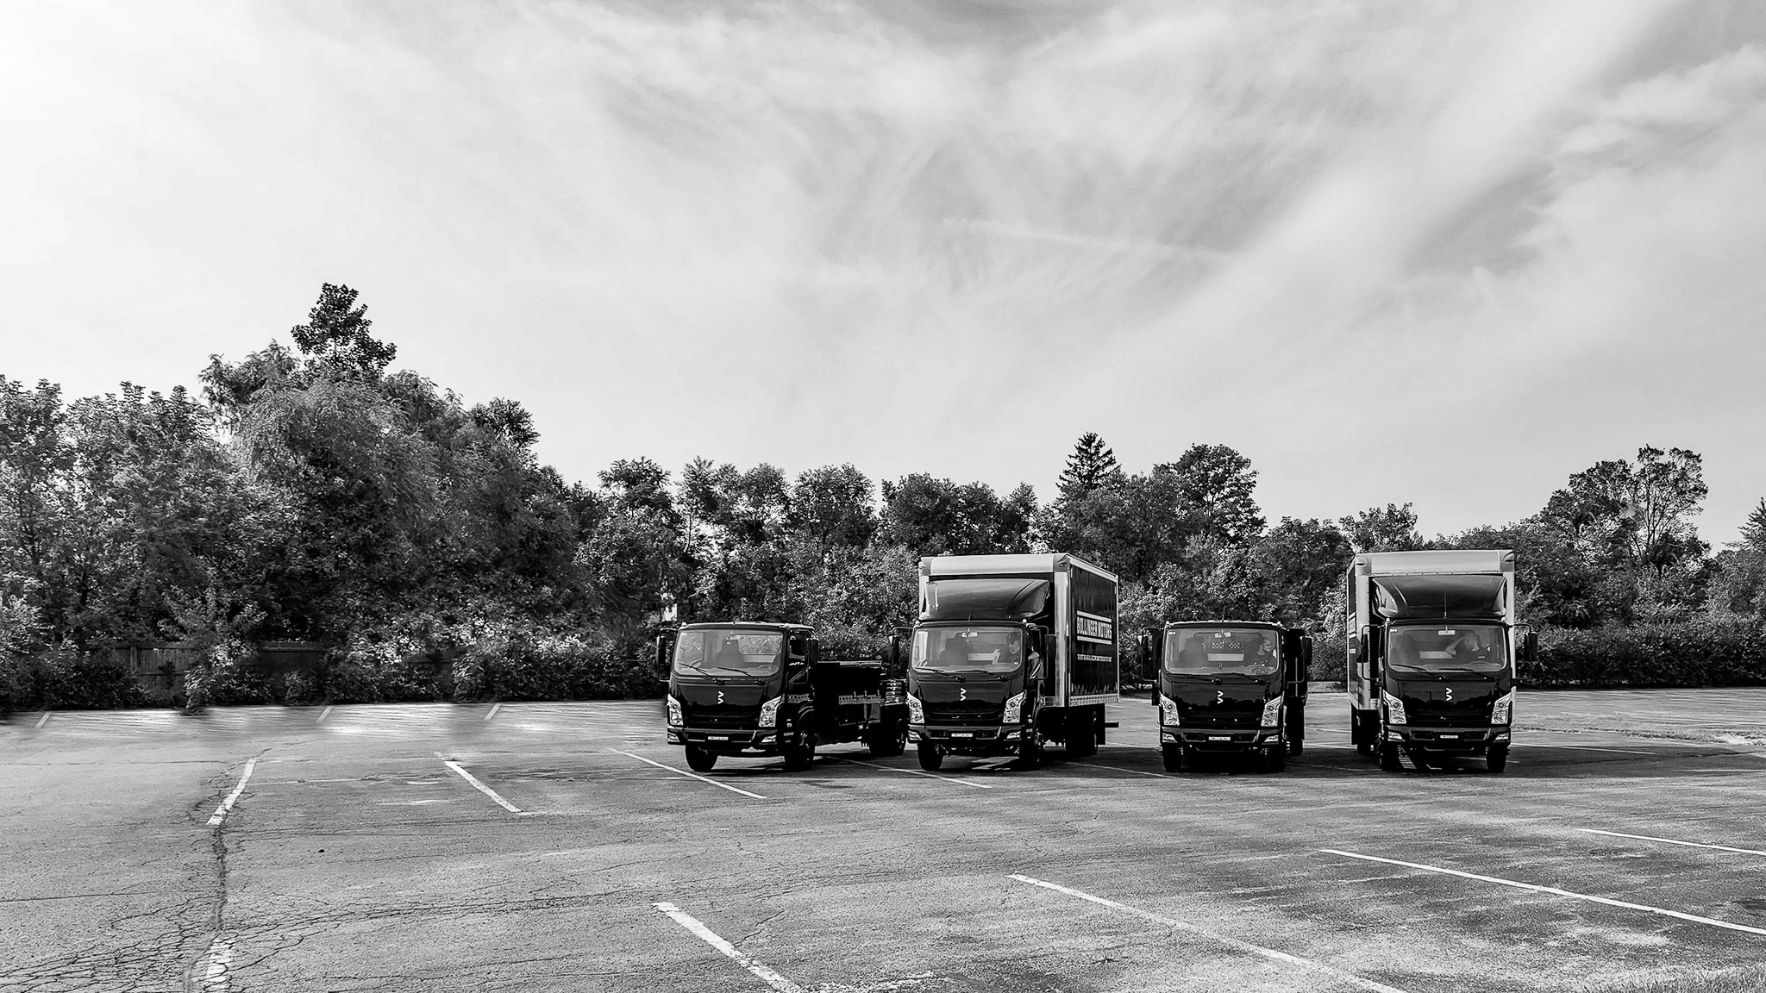

BOLLINGER MOTORS – OAK PARK, MI
CLASS 4 / 5 / 6
ALL-ELECTRIC
COMMERCIAL TRUCKS

Slide 2
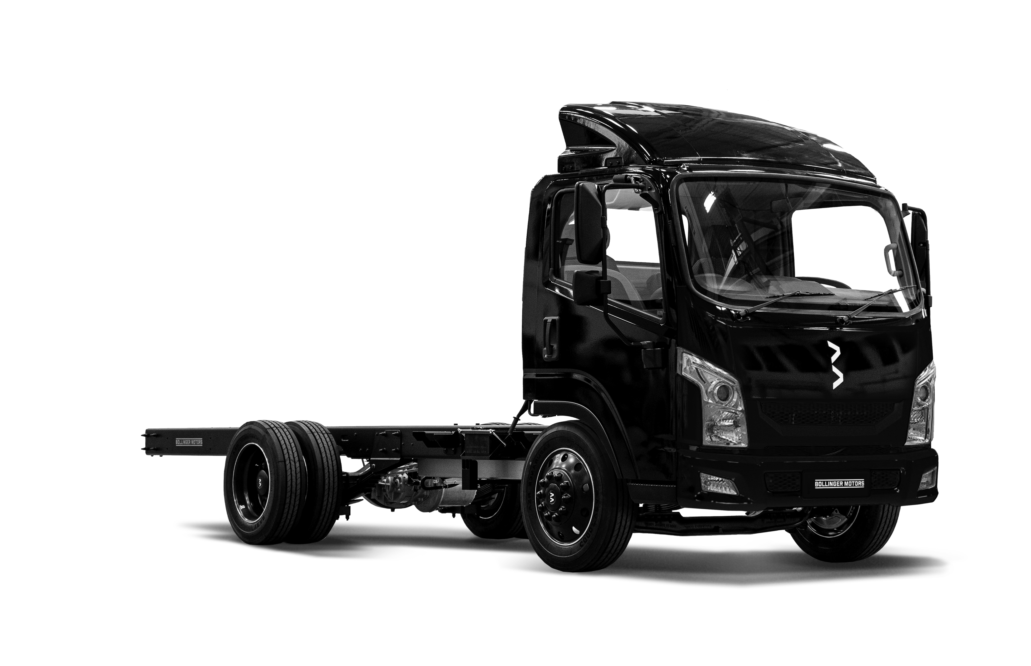

BOLLINGER B4 CLASS 4 ALL-ELECTRIC CHASSIS CAB
CLASS 4
>2
BATTERY 2 PACKS PROVIDE 158 KWH
RANGE 110-200 MILES
CHARGING (0 – 100%) J1772 CCS
    AC LEVEL 2 9 HOURS @ 80 AMPS
DCFC 1.5 HOURS @ 75 AMPS
POWER 363 HP
TORQUE 702 FT LBS
REAR AXLE DUAL WHEEL RWD
GAWR – 10,500 LBS
FRONT AXLE SOLID BEAM
GAWR – 6,500 LBS
TIRE SIZE 225/70R19.5
GVWR 15,500 LBS
PAYLOAD 7,325 LBS
WHEELBASE 158”
CAB TO AXLE 136”
TURN CIRCLE 44’
CAB TO BOX 4”
FRAME HEIGHT 30”
FRAME WIDTH 40”
BODY LENGTH 16 – 18’
PER CUSTOMER FEEDBACK: MEDIUM DUTY TRUCKS, ON AVERAGE, ARE DRIVEN LESS THAN 100 MILES PER DAY
All data preliminary and subject to change. Range estimated at half payload, running a typical urban delivery route.
CONFIDENTIAL

Slide 3
BOLLINGER B5 CLASS 5 ALL-ELECTRIC CHASSIS CAB
CLASS 5
>3
BATTERY 2 PACKS PROVIDE 158 KWH
RANGE 110-180 MILES
CHARGING (0 – 100%) J1772 CCS
AC LEVEL 2 9 HOURS @ 80 AMPS
DCFC 1.5 HOURS @ 75 AMPS
POWER 363 HP
TORQUE 702 FT LBS
REAR AXLE DUAL WHEEL RWD
GAWR – 13,500 LBS
FRONT AXLE SOLID BEAM
GAWR – 7,500 LBS
TIRE SIZE 225/70R19.5
GVWR 19,500 LBS
PAYLOAD 11,000 LBS
WHEELBASE 158 - 178”
CAB TO AXLE 136 - 156”
TURN CIRCLE 44-48’
CAB TO BOX 8”
FRAME HEIGHT 30”
FRAME WIDTH 40”
BODY LENGTH 16 – 20’
PER CUSTOMER FEEDBACK: MEDIUM DUTY TRUCKS, ON AVERAGE, ARE DRIVEN LESS THAN 100 MILES PER DAY
All data preliminary and subject to change. Range estimated at half payload, running a typical urban delivery route.
CONFIDENTIAL

Slide 4


2025 MY OPTIONAL EQUIPMENT
CLASS 4/5
>4
OPTIONAL
MOBILEYE ADVANCED DRIVER ASSISTANCE SYSTEM
FORWARD COLLISION WARNING
PEDESTRIAN & CYCLIST COLLISION WARNING
LANE DEPARTURE WARRNING
HEADWAY MONITORING & WARNING
SPEED LIMIT INDICATOR
CAB COLOR WHITE (STD) OTHER COLORS AVAILABLE
WHEEL COLOR WHITE, BLACK, GRAY
TERZO E PTO 10KW (13.4HP)
102” MIRRORS
CAB AIR SHIELD
All information preliminary and subject to change.
CONFIDENTIAL

Slide 5
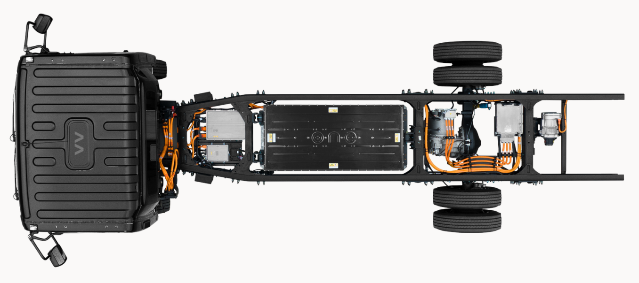
FLAT, CLEAN AND STRAIGHT FRAME RAILS MAKE IT MUCH EASIER TO ELECTRIFY YOUR FLEET
>5
HV COMPONENTS SAFELY
BETWEEN FRAME RAILS
SUSTAINABLE
LFP BATTERY PACKS
OPTIONAL E-PTO
10 Kw / 13.4 HP
FLAT
CLEAN
STRAIGHT
FRAME RAILS
SOLID REAR E-AXLE
STRAIGHT BEAM
FRONT AXLE
DUAL REAR WHEEL DRIVE
All data preliminary and subject to change.
CONFIDENTIAL

Slide 6
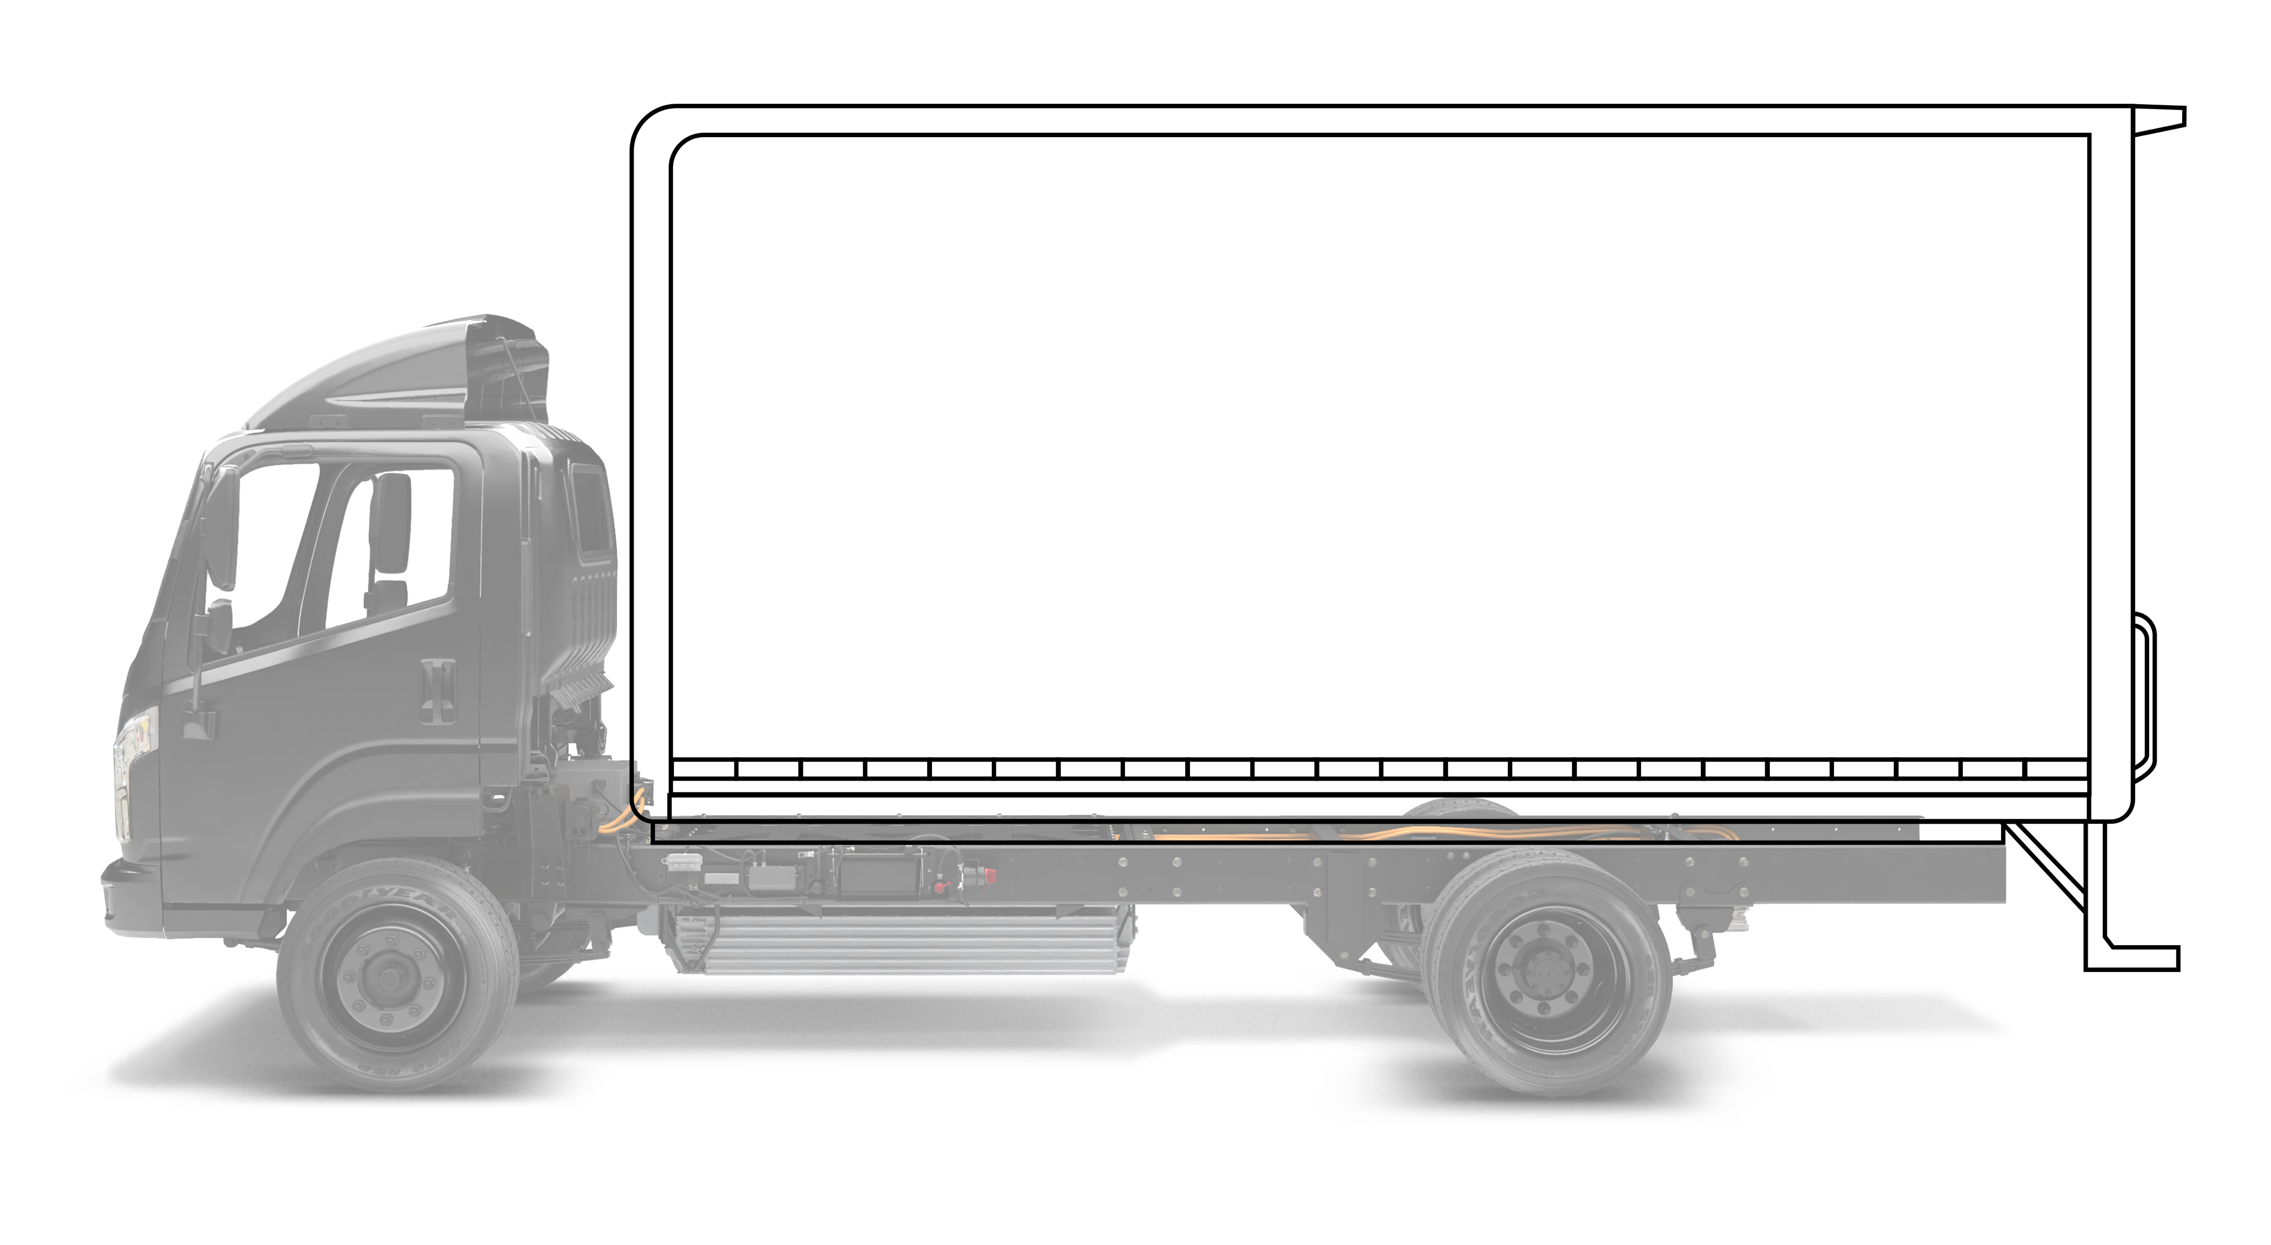
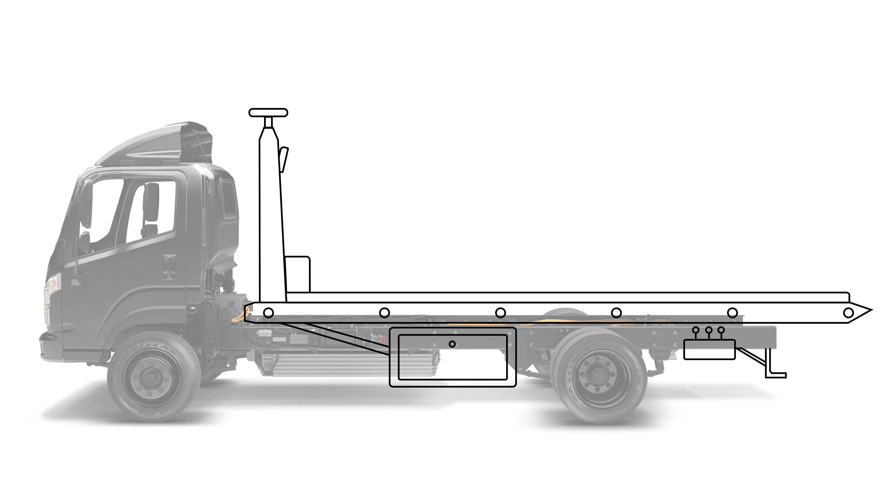
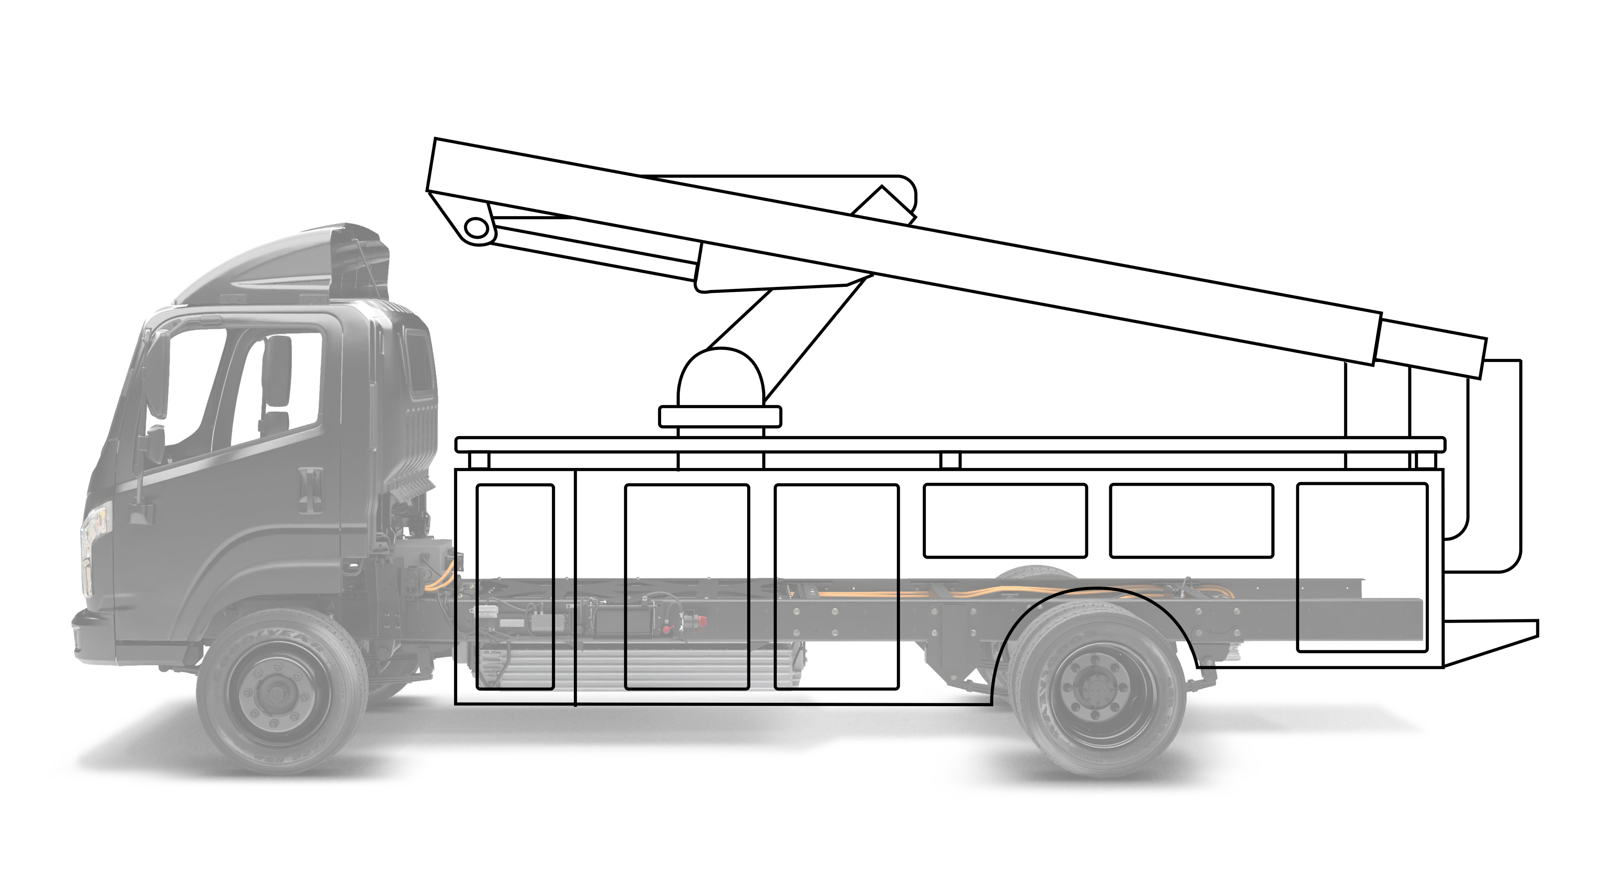
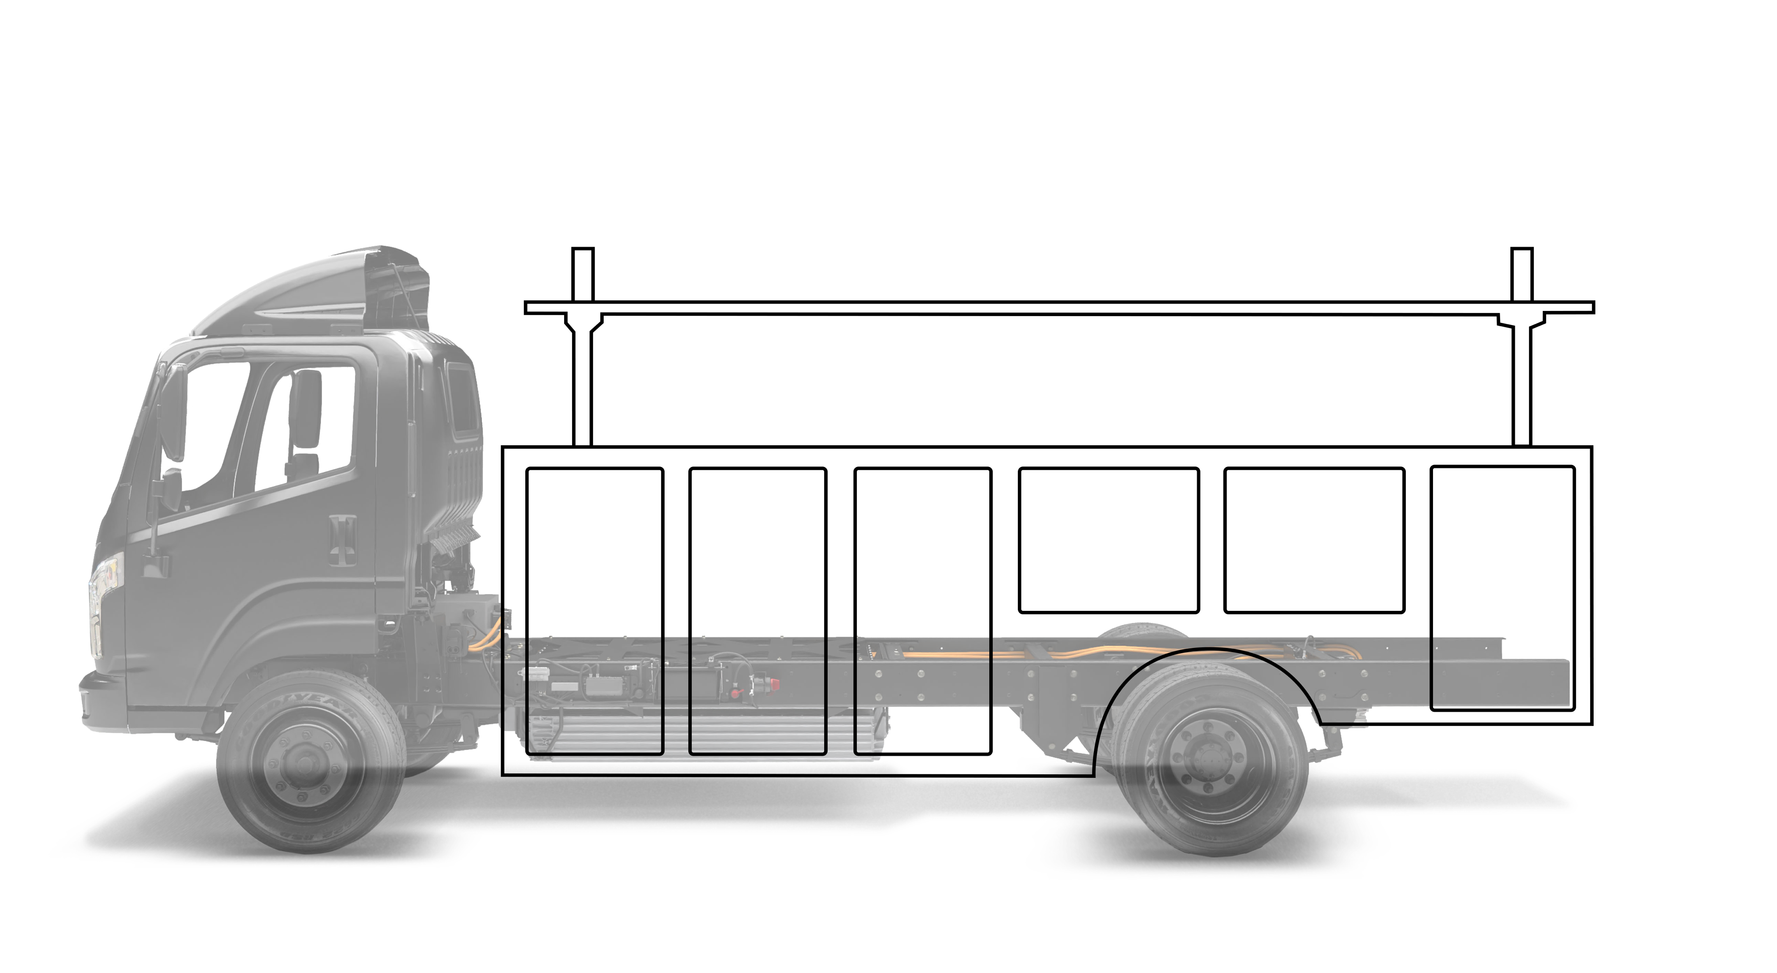
OUR CLEAN FRAME OFFERS UNLIMITED BODY APPLICATION OPPORTUNITIES
>6
CONFIDENTIAL

Slide 7
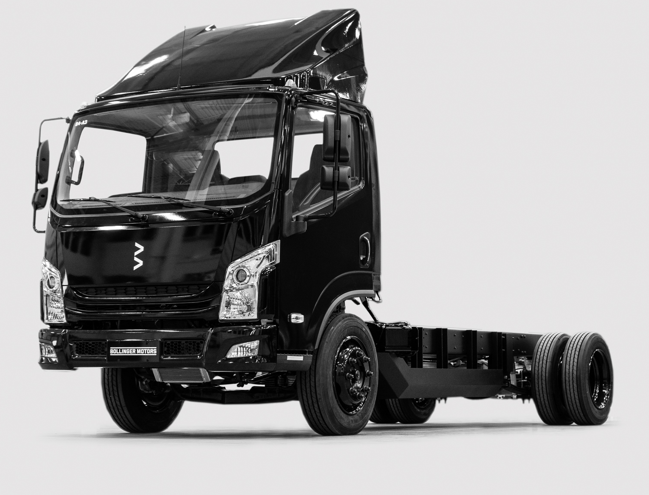
FLEETS BENEFIT GREATLY FROM THE INFLATION REDUCTION ACT
>7
IRA INCENTIVE = 30% OF VEHICLE PURCHASE PRICE UP TO $40,000
ENCOURAGING FLEETS TO TRANSITION MORE TRUCKS TO ELECTRIC FASTER
Vehicle must be 14,000 GVW or greater to qualify for full Inflation Reduction Act incentives.
CONFIDENTIAL

Slide 8


